Slide 1
Field Operations Safety at Solar Turbines
March 2011
Jim Low
HSSE Manager EAME
COMMITMENT

Slide 2
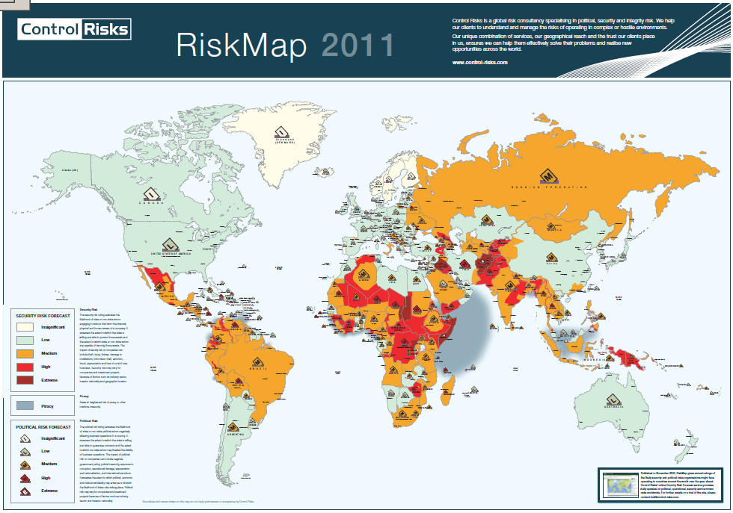
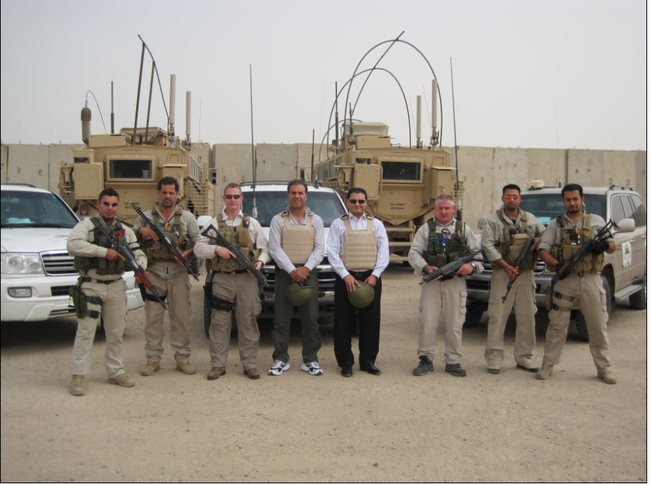
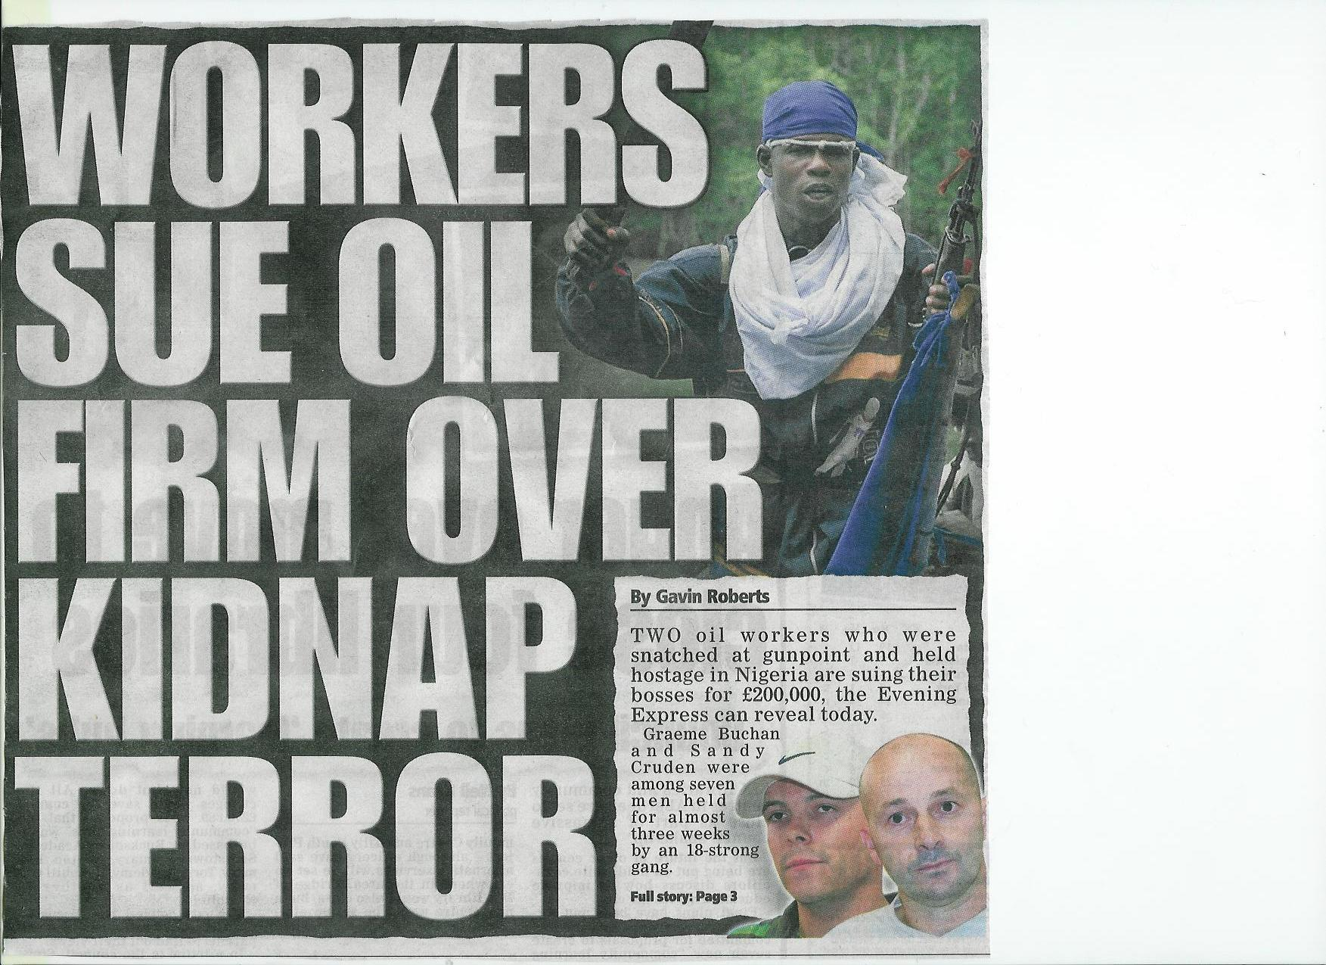
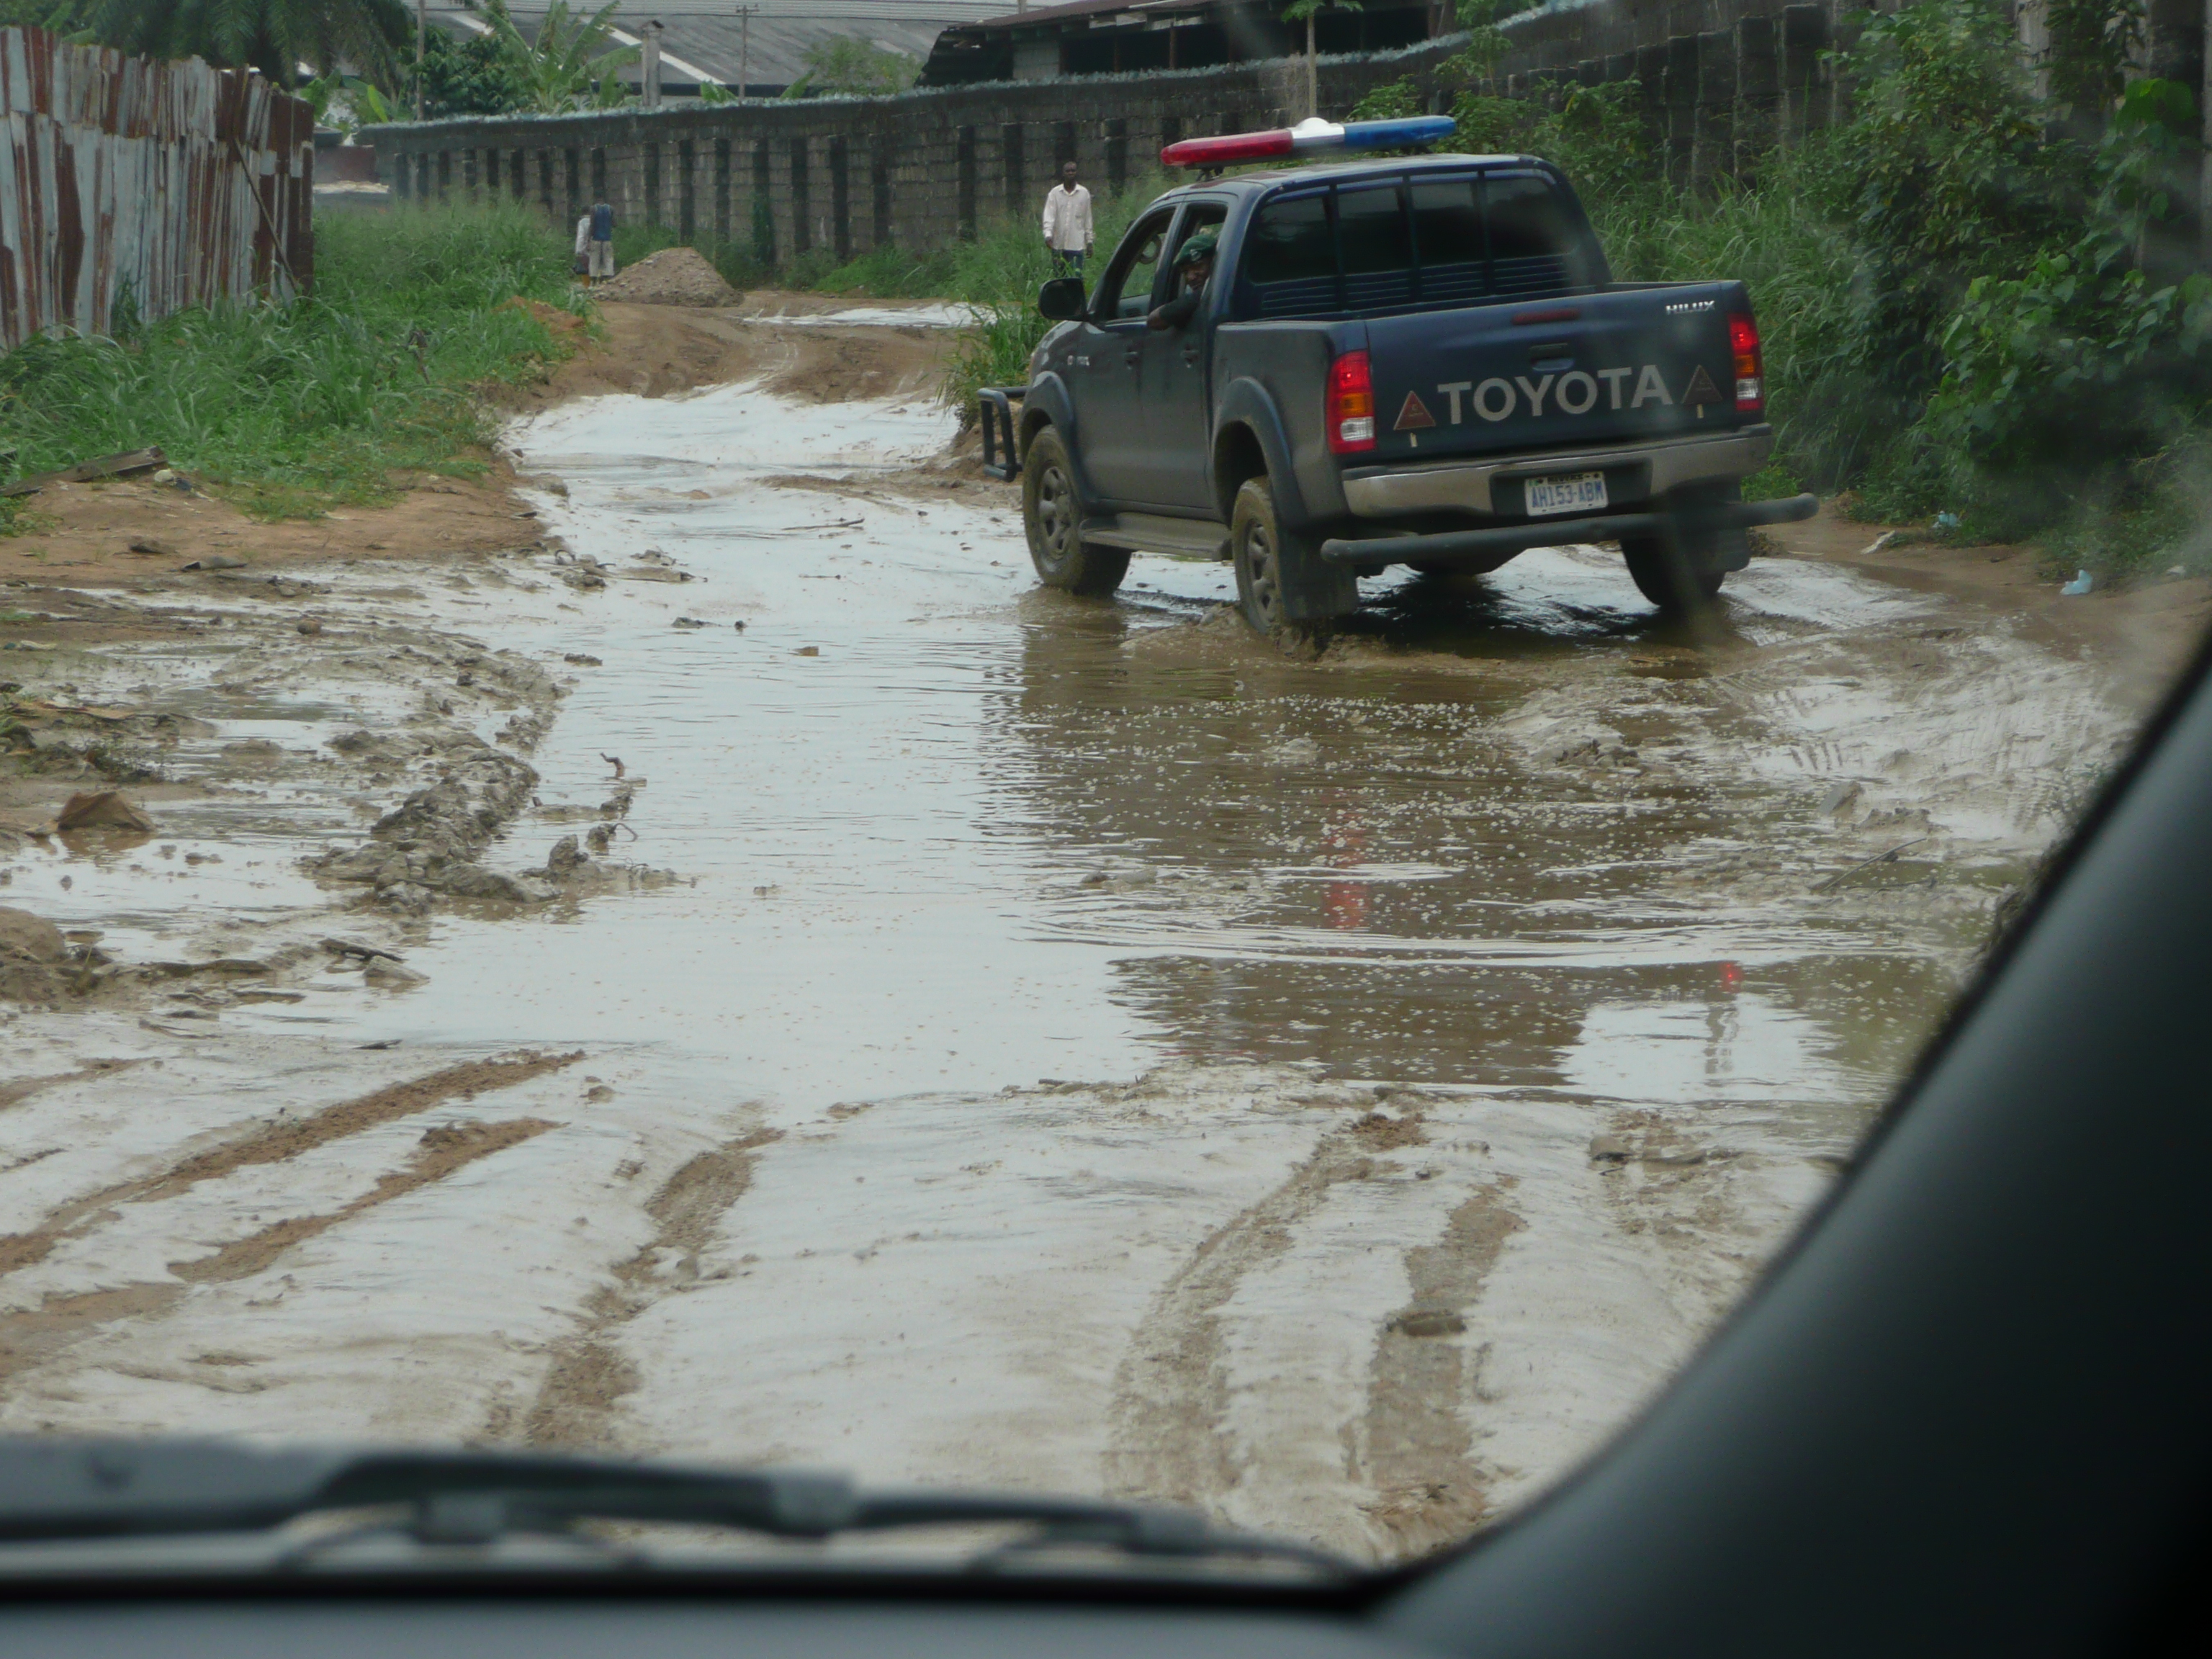
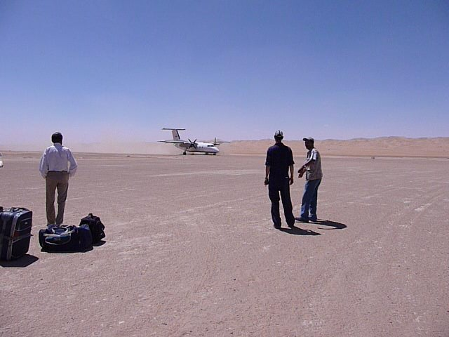
Major HSSE Challenges
Keeping 600+ Solar people in EAME safe….+ visitors
Cultural Differences
Customer Practices
Travel Safety and Security

Slide 3
Field Operations Risk Mitigation
Safety Management System
HSSE Training
Customer HSSE Cooperation and Liaison
Corporate Management Support
Stop Work Authority
Emergency Response Planning

Slide 4
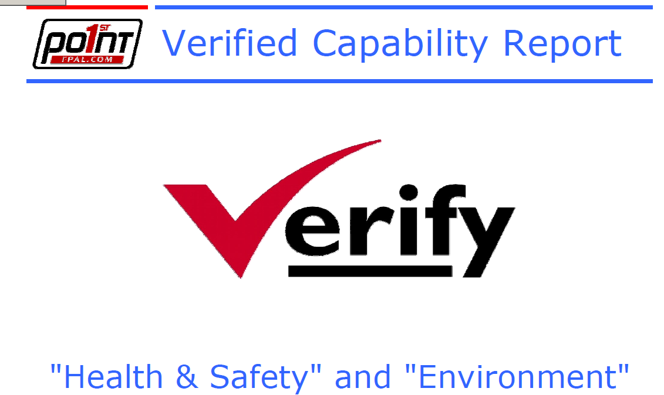
Solar Turbines Field Operations HSSE Management System
HSSE Management System
OHSAS 18001
Certified by DNV and FPAL
Incident Reporting and Investigation
Stop Work Authority
Risk Assessment

Slide 5
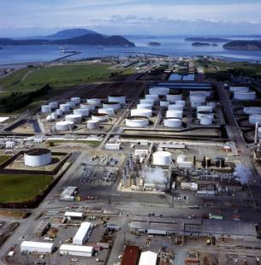
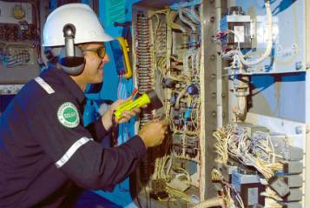
Field Operations Risk Assessments
Three Types of Risk Assessment
Travel Risk Assessment
Workplace Hazard Assessment (WHA)
Site Hazards (including getting to site)
Task Risk Assessment (TRA)
Task Hazards

Slide 6
Travel Risk Assessment
1
Air & Car Travel
2
Security
3
Site Accommodation
4
Food and Water
5
Local Wildlife
6
Adverse Weather
7
Communications

Slide 7
Workplace Hazard Assessment - WHA
Completed before going to site
Validated when on site
Assesses all general site hazards - including travel
Location
Adjacent work
Build standards
Is country or area safe?
Mode of travel
Security - Need to be met?
Phone numbers
Emergency Plan for site?
HSSE system on site?
Site housekeeping
Safety meetings?
Permit to work and LOTO systems?
Do workers use PPE?
Safety Orientation?
Condition of safety equipment?
Are unsafe conditions or acts followed up?
Evacuation drills?
Medical Clinic and first aid?
Accommodation clean?
H₂S on site?
Others??

Slide 8
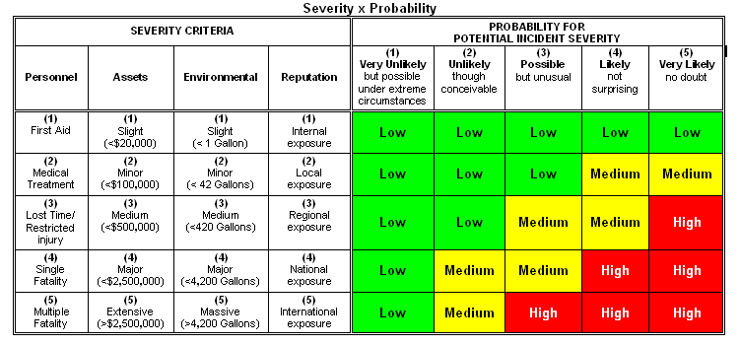
Risk Assessment Matrix
Solar uses a standard risk
matrix to assess and categorize risk:
Severity x Probability
Low Risk
Medium Risk
High Risk
Continue
Further analysis / mitigation / authorization needed
Work prohibited

Slide 9
Solar Turbines Field Operations HSSE Training
Prior to any deployment of new hires!
HSSE Management System training
Risk Assessment
Incident Reporting and Investigation
Permit to Work/Stop Work Authority
Travel Safety

Slide 10
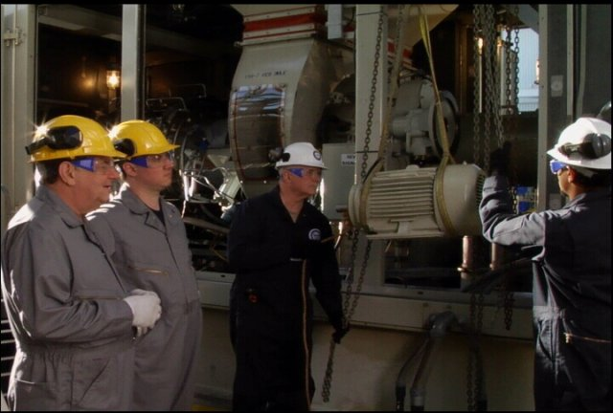
Solar Turbines Field Operations Job Specific HSSE Training
Job Specific HSSE Training
Electrical Safety Training
Small Bore Pipework
LOTO/PTW
Safety Intervention
Coaching Leaders for Vision Zero
Legal/Customer Requirements
BOSIET/HUET
MISTS
Oil & Gas UK Medical – Offshore and Remote Sites

Slide 11
Customer HSSE Cooperation & Liaison
HSSE Management System comparison
Very sensitive issue
Need to avoid confrontation
Emphasis on working together
WHA/TRA , Incident Reports –
key evidence during customer negotiations
HSSE Bridging Documents
Codes of Conduct

Slide 12
Corporate Management Support
President and Vice President approval required for High Risk countries
HSSE Steering Committee
Statement of Commitment signed by VP

Slide 13
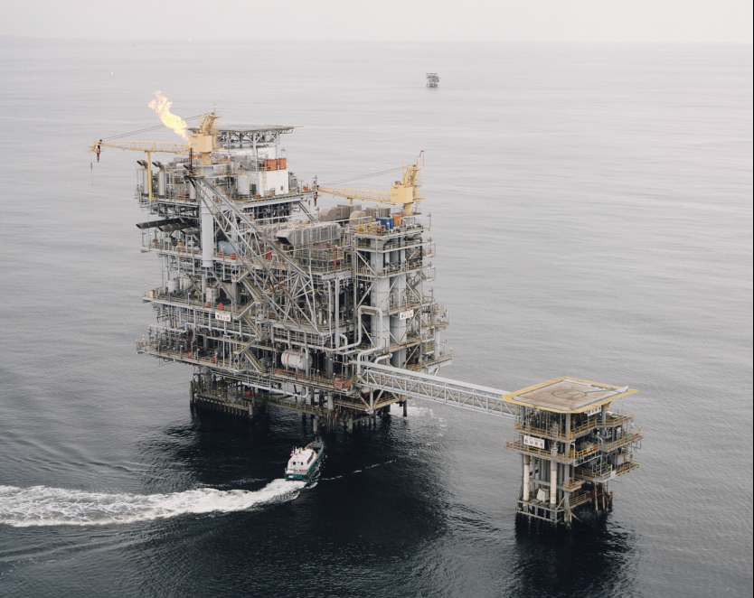
Stop Work Authority
Examples
Helicopter Baku – customer pressure
Travel in Algeria – terrorism
Travel in Yemen – terrorism
Qatar – unsafe customer practices
Congo – unsafe customer practices
Angola – unsafe customer practices
Corporate support and HSSE Training
Safety Intervention
Coaching Leaders for Vision Zero
Statement of Commitment – signed by VP

Slide 14
Offices/control rooms directly above process plant
Only inflatable life rafts are available –TEMPCs?
No Surfer Boats on stand by
Identified as H2S Site
Original design for day shift only
“We’re the operator -
you don’t tell us about safety on our platforms”
“Your North Sea standards don’t count down here!”

Slide 15
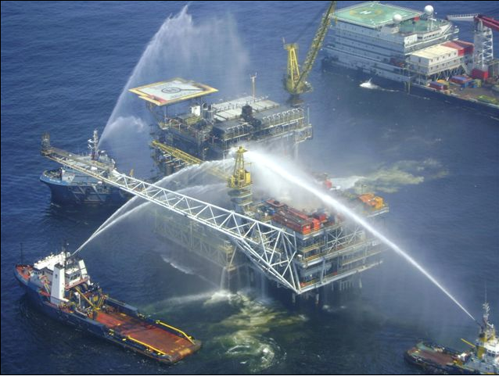

Slide 16
Emergency Response Planning
Regional Incident Management Team
Table Top Exercises 2007/2008/2010
2008/2009 – Dekastri / Medivac Nigeria/ San Diego Fires / Georgia / Niger Delta / Malobo / Gabon/ CAT Industrial Action/ H1N1
2010 – Platform Fire Angola/ Volcanic ash cloud/ Turkmenistan/ K&R/ Hot Strikes
2011 – Moscow Airport Bomb, Egypt Evacuation, Hot Strikes
ISOS
Control Risks
Google Earth Pro

